Slide 1
k-Nearest Neighbors (k-NN)

Slide 2
k-NN
One of the simplest and best-knows non-parametric method
Training data
Test observation x₀
Identify k records in the training data set that are similar to x₀
Using these similar records to classify x₀ into a class.

Slide 3
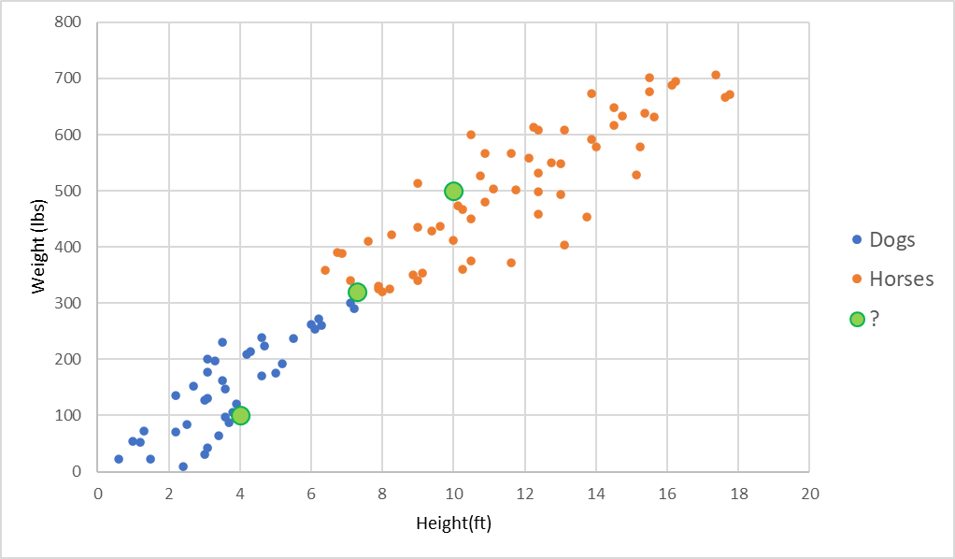
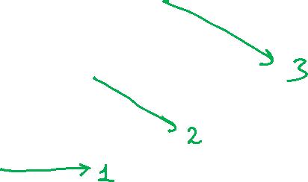
Example

Slide 4
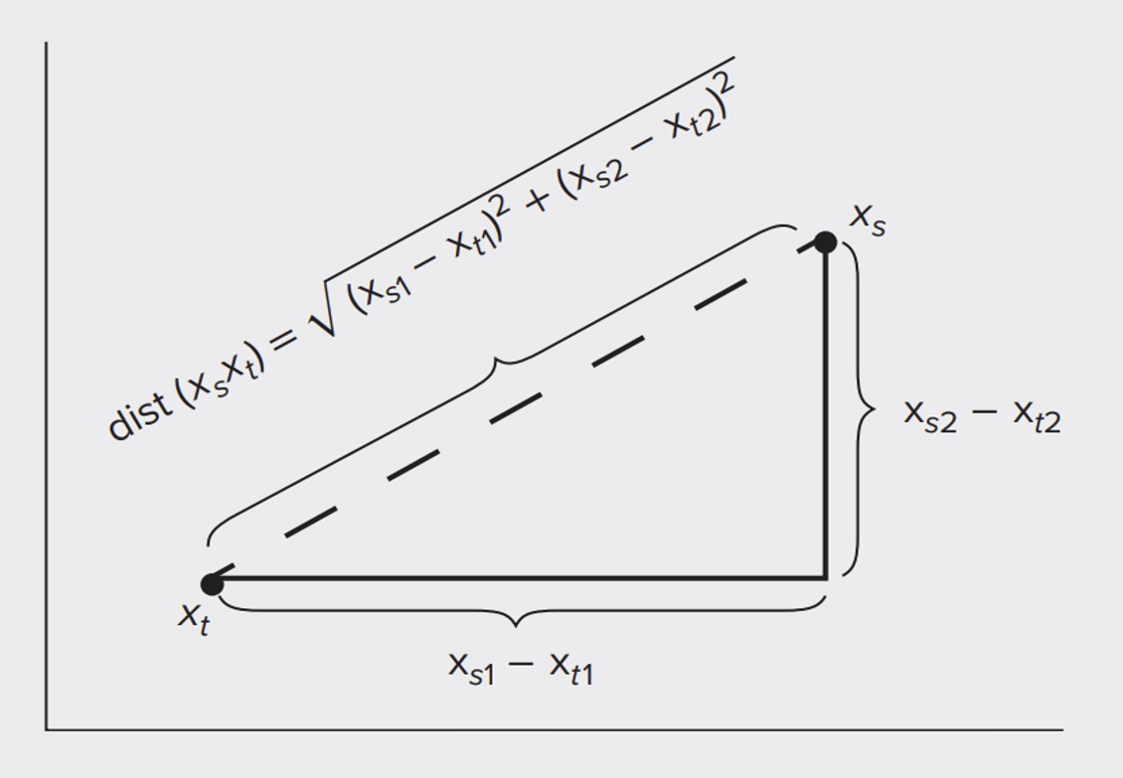
How to Compute the Distance?
Euclidean Distance:

Slide 5
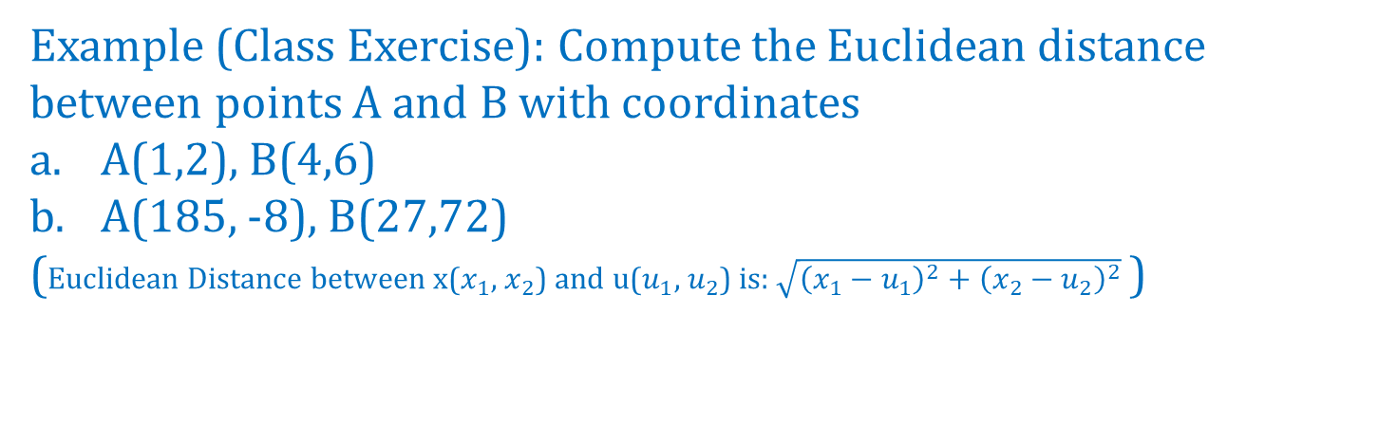
How to Compute the Distance?
Example (Class Exercise): Compute the Euclidean distance between points A and B with coordinates
A(1,2), B(4,6)
A(185, -8), B(27,72)
(Euclidean Distance between x($x_{1}$, $x_{2}$) and u($u_{1}$, $u_{2}$) is:$\sqrt{{\left(x_{1}−u_{1}\right)}^{2}+{\left(x_{2}−u_{2}\right)}^{2}}$ )

Slide 6
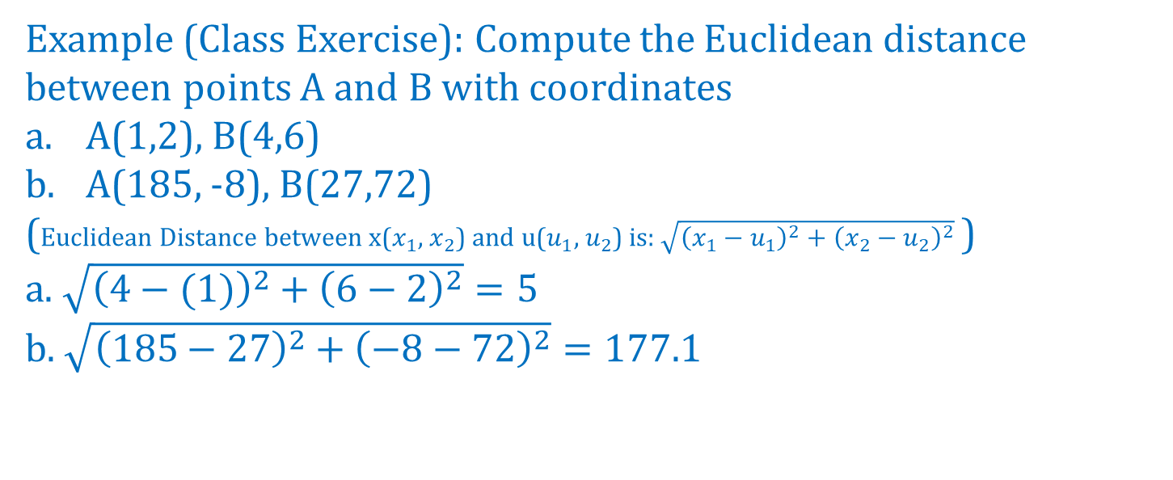
How to Compute the Distance?
Example (Class Exercise): Compute the Euclidean distance between points A and B with coordinates
A(1,2), B(4,6)
A(185, -8), B(27,72)
(Euclidean Distance between x($x_{1}$, $x_{2}$) and u($u_{1}$, $u_{2}$) is:$\sqrt{{\left(x_{1}−u_{1}\right)}^{2}+{\left(x_{2}−u_{2}\right)}^{2}}$ )
a. $\sqrt{{\left(4−(1)\right)}^{2}+{\left(6−2\right)}^{2}}=5$
b. $\sqrt{{\left(185−27\right)}^{2}+{\left(−8−72\right)}^{2}}=177.1$

Slide 7
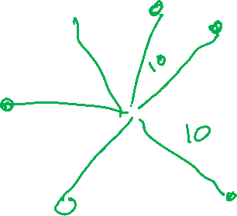
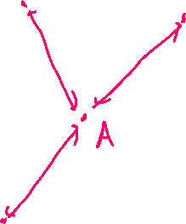
How to Compute the Distance?
Example (Home Exercise): What is the location of all points that are further from A by the same Euclidean distance, say 10 units?

Slide 8
Choosing k
k is the number of nearby neighbors to be used to classify the new record
k=1 means use the single nearest record
k=5 means use the 5 nearest records

Slide 9
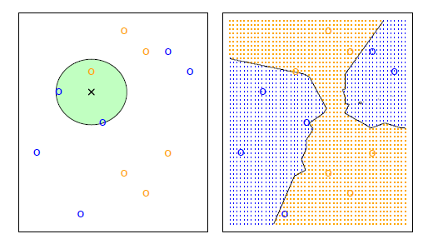
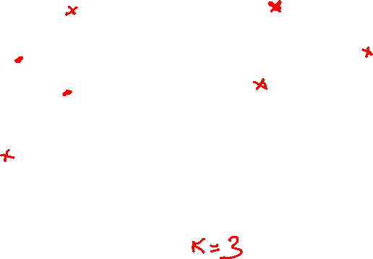

Slide 10
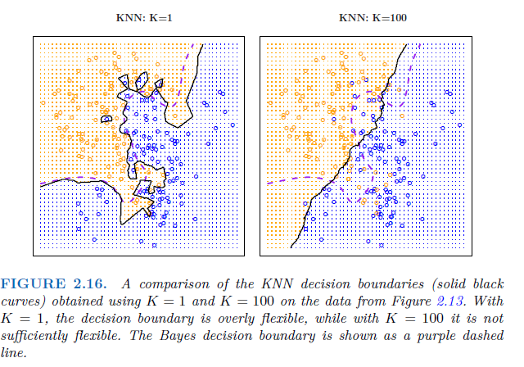
Selecting k matters

Slide 11
Low k vs. High k
Low values of k (1, 3, …) capture local structure in data (but also noise)
High values of k provide more smoothing, less noise, but may miss local structure
Note: the extreme case of k = n (i.e., the entire data set) is the same as the “naïve rule” (classify all records according to majority class)

Slide 12
Advantages
Simple
Works with any number of classes
No assumptions required about Normal distribution, etc.
Non-parametric

Slide 13
Shortcomings
Required size of training set increases exponentially with # of predictors, p
This is because expected distance to nearest neighbor increases with p (with large vector of predictors, all records end up “far away” from each other)
In a large training set, it takes a long time to find distances
These constitute “curse of dimensionality”
Categorical Features don’t work well.

Slide 14
Dealing with the Curse
- Reduce dimension of predictors (e.g., with PCA)
- Computational shortcuts that settle for “almost nearest neighbors”

Slide 15
Summary
Find distance between record-to-be-classified and all other records
Select k-nearest records
Classify it according to majority vote of nearest neighbors
Or, for prediction, take the as average of the nearest neighbors
“Curse of dimensionality” – need to limit # of predictors

Slide 16
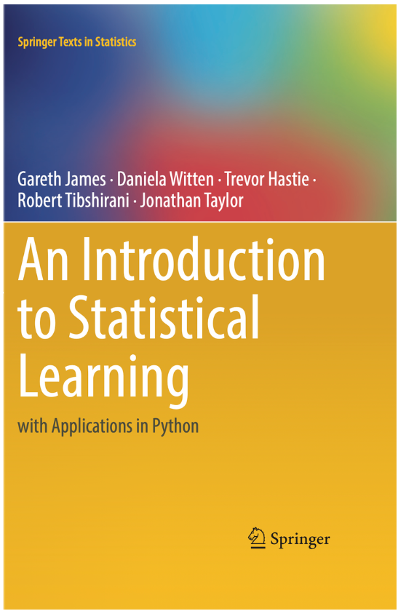

References
An Introduction to Statistical Learning with Applications in Python
Chapter 2.2 and 4.7
Data Mining for Business Analytics Concepts, Techniques and Applications in Python
Chapter 7

